Slide 1
Unit - II
Production and cost curves

Slide 2
A production function represents how inputs are transformed into outputs by a firm.
In particular, a production function describes the maximum output that a firm can produce for each specified combination of inputs.
In the short run, one or more factors of production cannot be changed, so a short-run production function tells us the maximum output that can be produced with different amounts of the variable inputs, holding fixed inputs constant.
In the long-run production function, all inputs are variable.

Slide 3
TP, AP and MP
Total product: It is the total output resulting from the efforts of all factors of production combined together at any time. If the inputs of all but one factor are held constant, the total product will vary with the quantity used of the variable factor.
Average Product: It is the total product per unit of the variable factor. When one unit of labor is employed, AP is 100, when two units of labor are employed, average product rises to 105. this goes on.
Marginal Product: It is the change in total product per unit change in the quantity of variable factor. In other words, it is the addition made to the total production by an additional unit of input.

Slide 4
Relationship between AP & MP
Both AP and MP are derived from TP
When AP rises as a result of an increase in the quantity of variable input, MP > AP
When AP is maximum, MP is equal to AP. In other words, MP curve cuts the AP curve at its maximum.
When AP falls, MP< AP.
The marginal product of labor is likely to increase initially because when there are more workers, each is able to specialize in an aspect of the production process in which he or she is particularly skilled.
For example, think of the typical fast food restaurant. If there is only one worker, he will need to prepare the burgers, fries, and sodas, as well as take the orders. Only so many customers can be served in an hour. With two or three workers, each is able to specialize, and the marginal product (number of customers served per hour) is likely to increase as we move from one to two to three workers.
Eventually, there will be enough workers and there will be no more gains from specialization. At this point, the marginal product will begin to diminish.

Slide 5
Production
The marginal product of labor will eventually diminish because there will be at least one fixed factor of production, such as capital. As more and more labor is used along with a fixed amount of capital, there is less and less capital for each worker to use, and the productivity of additional workers necessarily declines. Think for example of an office where there are only three computers. As more and more employees try to share the computers, the marginal product of each additional employee will diminish.
If any new labor is recruited, you should be concerned with the marginal product of the last worker hired, because the marginal product measures the effect on output, or total product, of hiring another worker. This in turn determines the additional revenue generated by hiring another worker, which should then be compared to the cost of hiring the additional worker.
The point at which the average product begins to decline is the point where average product is equal to marginal product. As more workers are used beyond this point, both average product and marginal product decline. However, marginal product is still positive, so total product continues to increase. Thus, it may still be profitable to hire another worker.

Slide 6
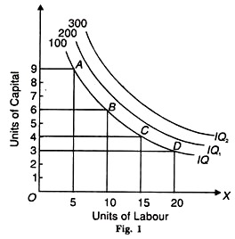
A production function describes the maximum output that can be achieved with any given combination of inputs.
An isoquant identifies all of the different combinations of inputs that can be used to produce one particular level of output.
Isoquants are called equal-product or iso-product curves.
Again, as all the combinations yield the same level of output the producer tends to be indifferent among them.
Hence, isoquants are also known as producer indifference curves.

Slide 7
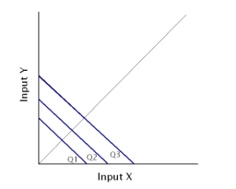
Iso-Cost lines
Iso-cost lines represent the prices of factors. An iso-cost line graphically represents all the combinations of the inputs which the firm can achieve with a given budget for production or given outlay.
Suppose the firm has 100 Rs. which it can spend on combinations of factor X and factor Y, the former priced at Rs. 10 per unit and the latter priced at Rs. 20. The firm can spend the entire amount on factor X or factor Y.
Further, there will be various combinations of both factors which amount to the outlay. The iso-cost line represents all these combinations. Q1, Q2 and Q3 are three different isocosts.
The isocost on the right represents a higher outlay.

Slide 8
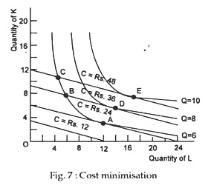
Production optimisation
Isocosts and Isoquants can together help us to determine the optimum production for a firm.
We can achieve production optimisation in two ways.
Either we can maximize the production for a given outlay or we can minimize the cost of producing a given level of output.
In case a firm has decided to achieve a given level of production, the next step would be to choose the combination of factors to achieve this target.
Definitely, a rational firm would choose the least cost combination.
This least cost combination is found out by superimposing the iso-quant on the iso-cost line.
For example, the cost would be Rs. 48 at C, Rs. 36 at B and Rs. 24 at A. The cheapest method is at A, where the iso­quant for output of six (Q = 6) is tangent to an isocost line (C = Rs. 24).

Slide 9
Why isoquants shapes differ and what it signifies
Convex isoquants indicate that some units of one input can be substituted for a unit of the other input while maintaining output at the same level. In this case, the MRTS is diminishing as we move down along the isoquant. This tells us that it becomes more and more difficult to substitute one input for the other while keeping output unchanged.
Linear isoquants imply that the slope, or the MRTS, is constant.This means that the same number of units of one input can always be exchanged for a unit of the other
input holding output constant. The inputs are perfect substitutes in this case.
L-shaped isoquants imply that the inputs are perfect complements, and the firm is producing under a fixed proportions type of technology. In this case the firm cannot give up one input in exchange for the other and still maintain
the same level of output. For example, the firm may require exactly 4 units of capital for each unit of labor, in which case one input cannot be substituted for the other.
MRTS is the amount by which the quantity of one input can be reduced when the other input is increased by one unit, while maintaining the same level of output. If the MRTS is 4 then one input can be reduced by 4 units as the other is increased by one unit, and output will remain the same.

Slide 10
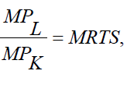


How to calculate MRTS when marginal product of labor and marginal product of capital is given
The marginal rate of technical substitution is defined at the ratio of the two marginal products.
The marginal rate of technical substitution, MRTS, is the absolute value of the slope of an isoquant. If the inputs are perfect substitutes, the isoquants will be linear. To calculate the slope of the isoquant, and hence the MRTS, we need to know the rate at which one input may be substituted for the other. All we know is that it is a constant number. We need to know the marginal product of each input to determine the MRTS.
the marginal rate of technical substitution in the following formula:
is Marginal product of Labor
is Marginal product of Capital

Slide 11
Law of variable proportion
This law exhibits the short-run production functions in which one factor varies while the others are fixed.
Also, when you obtain extra output on applying an extra unit of the input, then this output is either equal to or less than the output that you obtain from the previous unit.
The Law of Variable Proportions concerns itself with the way the output changes when you increase the number of units of a variable factor.
In other words, the law exhibits the relationship between the units of a variable factor and the amount of output in the short-term.
The law states that keeping other factors constant, when you increase the variable factor, then the total product initially increases at an increasing rate, then increases at a diminishing rate, and eventually starts declining.

Slide 12
Let’s say that you have 10 acres of land and 1 unit of labour for production. Therefore, the land-labour ratio is 10:1. Now, if you keep the land constant but increase the units of labour to 2, the land-labour ratio becomes 5:1.
Therefore, as you can see, the law analyses the effects of a change in the factor ratio on the amount of out and hence called the Law of Variable Proportions

Slide 13
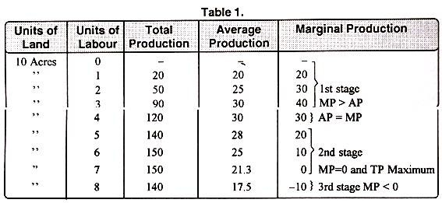
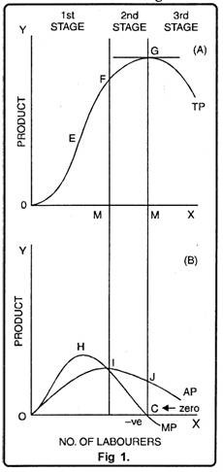
TP – Total Product
MP – Marginal Product
AP – Average product
Y axis – Quantity of product
X axis – No. of laborers

Slide 14
Up to point ‘E’, total product is increasing at increasing rate. Between points E and G it is increasing at the decreasing rate. Here marginal product has started falling.
At point ‘G’ i.e., when 7 units of labourers are employed, total product is maximum while, marginal product is zero. Thereafter, it begins to diminish corresponding to negative marginal product. In the lower part of the figure MP is marginal product curve.
Up to point ‘H’ marginal product increases. At point ‘H’, i.e., when 3 units of labourers are employed, it is maximum. After that, marginal product begins to decrease. Before point ‘I’ marginal product becomes zero at point C and it turns negative. AP curve represents average product. Before point ‘I’, average product is less than marginal product. At point ‘I’ average product is maximum. Up to point T, average product increases but after that it starts to diminish.

Slide 15
1. First Stage:
First stage starts from point ‘O’ and ends up to point F. At point F average product is maximum and is equal to marginal product. In this stage, total product increases initially at increasing rate up to point E. between ‘E’ and ‘F’ it increases at diminishing rate. Similarly marginal product also increases initially and reaches its maximum at point ‘H’. Later on, it begins to diminish and becomes equal to average product at point T. In this stage, marginal product exceeds average product (MP > AP).
2. Second Stage:
It begins from the point F. In this stage, total product increases at diminishing rate and is at its maximum at point ‘G’ correspondingly marginal product diminishes rapidly and becomes ‘zero’ at point ‘C’. Average product is maximum at point ‘I’ and thereafter it begins to decrease. In this stage, marginal product is less than average product (MP < AP).
3. Third Stage:
This stage begins beyond point ‘G’. Here total product starts diminishing. Average product also declines. Marginal product turns negative. Law of diminishing returns firmly manifests itself. In this stage, no firm will produce anything. This happens because marginal product of the labour becomes negative. The employer will suffer losses by employing more units of labourers. However, of the three stages, a firm will like to produce up to any given point in the second stage only.

Slide 16
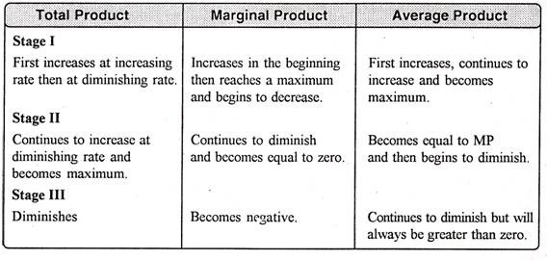

Slide 17
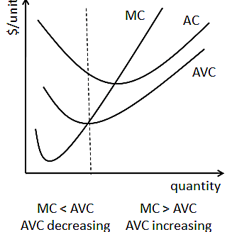
Relationship between Marginal cost and Average variable cost
When marginal cost is increasing, average variable cost can be either increasing or decreasing as shown in the diagram below. Marginal cost begins increasing at output level q1, but AVC is decreasing.
This happens because MC is below AVC and is therefore pulling AVC down. AVC is decreasing for
all output levels between q1 and q2. At q2, MC cuts through the minimum point of AVC, and AVC
begins to rise because MC is above it. Thus for output levels greater than q2, AVC is increasing.

Slide 18
Law of Returns to Scale
The law of returns to scale explains the proportional change in output with respect to proportional change in inputs
The degree of change in output varies with change in the amount of inputs. For example, an output may change by a large proportion, same proportion, or small proportion with respect to change in input.
On the basis of these possibilities, law of returns can be classified into three categories:
i. Increasing returns to scale
ii. Constant returns to scale
iii. Diminishing returns to scale

Slide 19
Increasing returns to scale
When there is an increase in the scale of production, the average cost per unit produced is lower. This is because at this stage an organization enjoys high economies of scale.
i. Technical and managerial indivisibility:
Ii.Specialization: Implies that high degree of specialization of man and machinery helps in increasing the scale of production.
Concept of Dimensions:
Refers to the relation of increasing returns to scale to the concept of dimensions. According to the concept of dimensions, if the length and breadth of a room increases, then its area gets more than doubled.

Slide 20
Constant Returns to Scale:
The production is said to generate constant returns to scale when the proportionate change in input is equal to the proportionate change in output. For example, when inputs are doubled, so output should also be doubled, then it is a case of constant returns to scale.
Diminishing Returns to Scale:
Diminishing returns to scale refers to a situation when the proportionate change in output is less than the proportionate change in input. For example, when capital and labor is doubled but the output generated is less than doubled, the returns to scale would be termed as diminishing returns to scale.

Slide 21
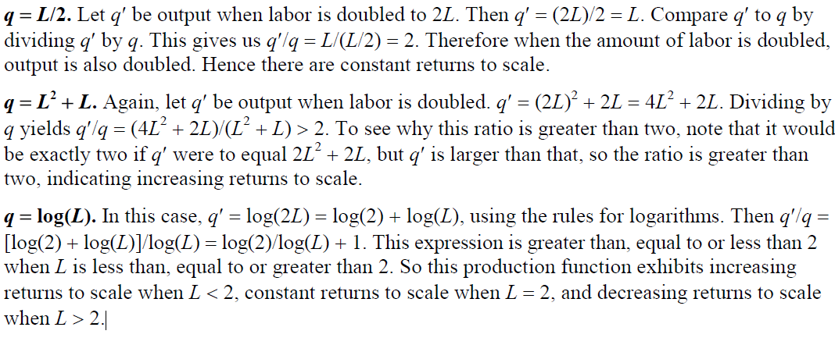

Slide 22
Money cost vs real cost:
Money cost - Total money expenses incurred by a firm
Cost of raw materials
Wages and salaries
Expenditure on machinery and equipment
Depreciation on machines, buildings and capital goods
Interest on capital
Other expenses like advertisement, insurance premium and taxes
Normal profit of the entrepreneur

Slide 23
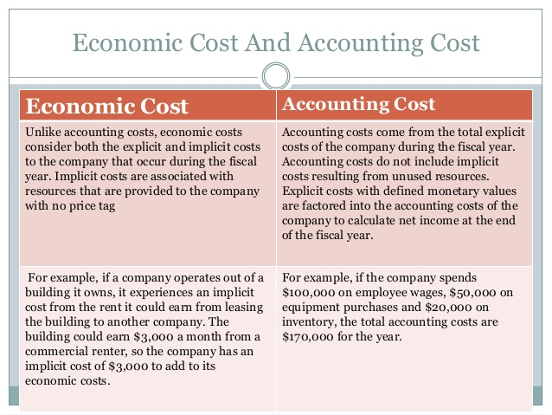
Cost of production

Slide 24


Slide 25
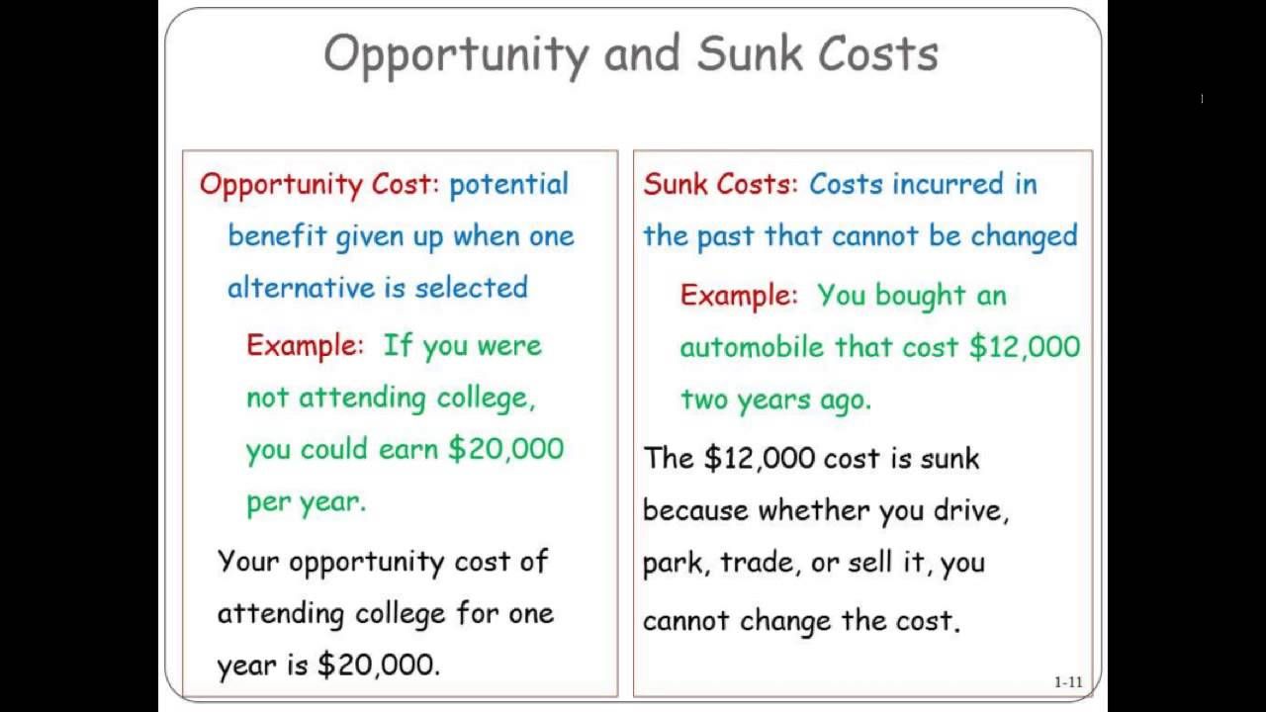

Slide 26
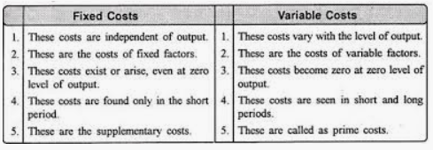

Slide 27
Short run – certain factors cannot be changed

Slide 28
Short run and long run – impact of VC and FC
Losses occur when revenues do not cover total costs. If revenues are greater than variable costs, but not total costs, the firm is better off producing in the short run rather than shutting down, even though it is incurring a loss. The reason is that the firm will be stuck will all its fixed cost and have no revenue if it shuts down, so its loss will equal its fixed cost.
If it continues to produce, however, and revenue is greater than variable costs, the firm can pay for some of its fixed cost, so its loss is less than it would be if it shut down.
In the long run, all costs are variable, and thus all costs must be covered if the firm is to remain in business.

Slide 29
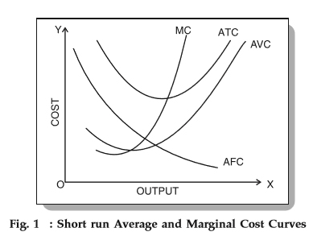

Slide 30
Short run costs
By short-run is meant that period of time within which a firm can vary its output by varying only the amount of variable factors, such as labour and raw material.
In the short-run period, the fixed factors such as capital equipment, management personnel, the factory buildings, etc., cannot be altered.
If, therefore, a firm wants to increase production in the short-run, it can do so only by hiring more workers or buying and using more raw materials. It cannot, in the short-run, enlarge the size of the existing plant or build a new plant of a bigger capacity. Thus, in the short-run, only variable factors can be varied, while the fixed factors remain the same.
On the other hand, long-run is a period of time during which the quantities of all factors, variable as well as fixed, can be adjusted. Thus, in the long-run, output can be increased by increasing capital equipment or by increasing the size of the existing plant or by installing a new plant of bigger capacity.

Slide 31
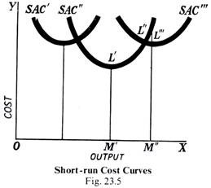
Short run cost curve
To begin with, let us suppose that the firm has the short-run cost curve SAC “. ,In this case, the optimum output will be OM’. Now, if it is desired to increase the output to OM” in the short-run, it can be obtained at the average cost M”L” along the short-run cost curve SAC”, because in the short-run, the scale of operations is fixed. But, in the long run, a new and bigger plant can be built on which OM ” is the optimum output. That is, the firm has now a short-run average cost curve SAC “‘, and by increasing the scale of its operations, the firm can produce the OM” output at a cost of M “L” ‘ instead of M “L”

Slide 32
Thus, it will be seen that, at any scale of operations in the short-run, a firm will have regions of rising and falling costs. But, in the long-run, the firm can produce on a completely different cost curves to the left (i.e., SAC’) or right (i.e., SAC”’) of the original cost curve (i.e., SAC”). For each different scale represented by a different short-run cost curve, there will be an output where the average cost is the minimum. This is the optimum output.

Slide 33
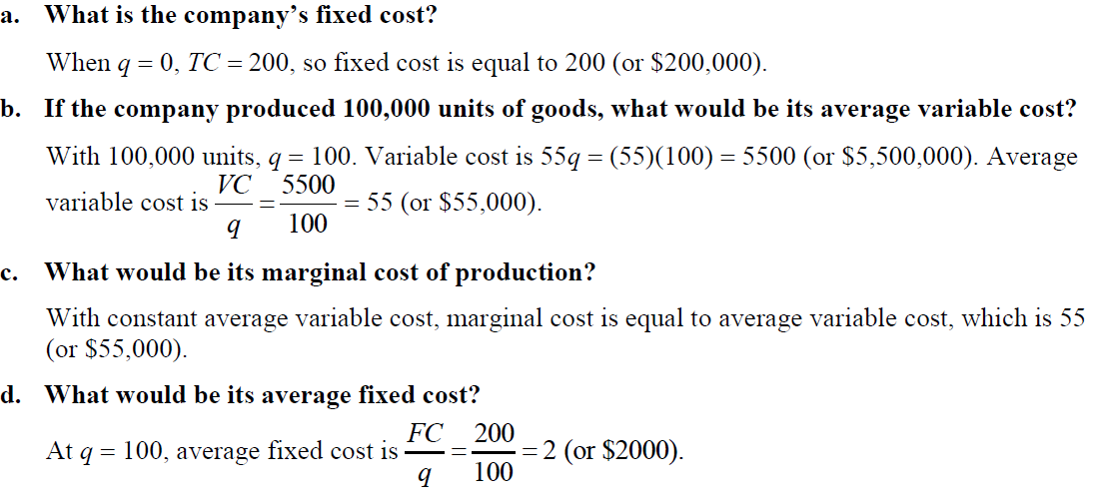
Some problems…
If TC= 200+55q, which is the short-run cost of the company,

Slide 34
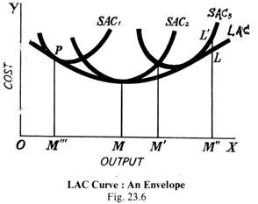
Long run cost curve
In the diagram (Fig. 23.6), SAC,, SAC,, and SAC, are the short-run cost curves corresponding to the different scales of operations. In each case, the firm in question will be producing the desired output at the lowest cost. For example, OM”’ output is produced at PM”’ in the scale of operations represented by the curve SAC OM will be produced on SAC, and so on.

Slide 35
It should be clearly understood that only in the long-run can the scale of operations be altered; in the short-run, it will be fixed, and the average cost of output above or below the optimum level will necessarily rise along the short-run cost curve in question, whether it be SAC,, SAC ₂ and SAC₃. A long-run average cost will show what the long-run cost of producing each output will be. It will be seen, in the Fig. 23.6 that the short-run average cost curve SAC, has a lower minimum point than either the curves SAC, and SAC₃. The optimum output of the firm is obtained at OM.

Slide 36
The long-run average cost curve LAC is a tangent to all the short-run cost curves SAC, SAC₂ and SAC. The LAC curve will, therefore, be U-shaped like the short-run cost curves, but its U-shape will be less pronounced than that of the short-run cost curves. It will be flatter. That is why the long-run cost curve is called an ‘Envelope’, because it envelops all the short-run cost curves.
The cost curves, whether short-run or long-run, are U-shaped because the cost of production first starts falling as output is increased owing to the various economies of scale. But after touching the lowest point at the optimum output level, it starts rising, and goes on rising if production is continued beyond the optimum level.

Slide 37
This obviously makes a U-shape. But, as we have said already, the U-shape of the long-run cost curves is less pronounced. In other words, the long-run average costs are flatter than the short-run curves. The longer the period to which the curve relates, the less pronounced will be the U-shape of the cost curves. By the long period, we mean the period during which the size and organisation of the firm can be altered to meet the changed conditions.

Slide 38
Why is the Long-run Cost Curves Flatter?
The answer can be given in terms of fixed and variable costs. We have said before that no costs are fixed in the long-run, i.e., in the long run all costs are variable. In other words, the longer the period, the fewer costs will be fixed and the more costs will be variable. That is, in the long period, the total fixed costs can be varied, whereas in the short period, this amount is fixed absolutely.
In the short-run, if output is reduced, average cost will rise because the fixed costs will work out at a higher figure. But, in the long-run, fixed costs can be reduced if the output is continued at the low level. Hence, average fixed cost will be lower in the long than in the short run.
The variable costs will not rise as sharply in the long-run as in the short-run, because in the long-run, the size of the firm can be increased to deal more economically with an increased output. Thus, LAC curves are flatter than the short-run cost curves, because, in the long-run, the average fixed cost will be lower, and variable costs will not rise to sharply as in the short period.

Slide 39
Why Are Long-Run Cost Curves U-Shaped?
We have explained above that the long-run cost-curves are U-Shaped. That is, as output is increased, the cost per unit falls, then it reaches a minimum after which it starts ascending so that it takes the shape of U. How do we account for this U-shape? The reason is that the cost curve falls on account of the various economies of scale. But when the firm has expanded too much, economies are changed into diseconomies and the cost curve starts rising.

Slide 40
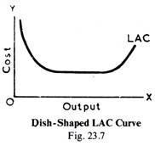
Dish-Shaped Cost Curves:
Empirical studies have further revealed that there is relatively very large flat portion or a large horizontal region in the centre of the long-run average cost curve. This means that for a considerable range of production, the long-run average cost remains the same and then it moves up at the right and making a sort of dish or saucer.
This means that the economies of scale are exhausted at some scale of operation, but diseconomies do not occur yet. But after the scale is enlarged beyond a point, dis-economies emerge and bring about a rise in the long-run average cost and thus give the curve a saucer or dish shape.

Slide 41
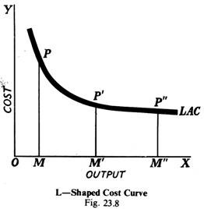
L-shaped Cost Curves:
Recently some economists have put forward the view based on recent empirical studies that the cost curves take the shape of ‘L’ and not ‘U’. According to them, the shape of the long-run cost curve will be something as is given in Fig. 23.8.
In this diagram (Fig. 23.8), first OM is output produced and PM is the average cost of production including both the fixed and variable costs. When the output is expanded to OM”, the cost is P’M’, and when output is further increased to OM”, the cost is P”M” which is almost equal to P’M’.

Slide 42
From this point onwards, the cost per unit is stabilized so that, whatever the output, the cost per unit remains practically the same and the LAC comes to have L-shape. This means that the cost first falls over a range of output, and then it neither rises nor falls but remains flat.
The following two reasons are given in support of the L-shape:
(i) Rapid technical progress brings about a sharp decline in unit cost up to a certain point and then stabilizes it.
(ii) With lapse of time the producer learns to produce at lower cost.

Slide 43
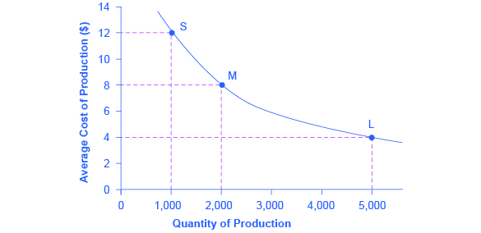
What happens to a firm’s average costs when it increases its level of output in the long run?
Many industries experience economies of scale.
Economies of scale refers to the situation where, as the quantity of output goes up, the cost per unit goes down. This is the idea behind “warehouse stores” like Costco or Walmart.
In everyday language: a larger factory can produce at a lower average cost than a smaller factory. Figure 1 illustrates the idea of economies of scale, showing the average cost of producing an alarm clock falling as the quantity of output rises. For a small-sized factory like S, with an output level of 1,000, the average cost of production is $12 per alarm clock. For a medium-sized factory like M, with an output level of 2,000, the average cost of production falls to $8 per alarm clock. For a large factory like L, with an output of 5,000, the average cost of production declines still further to $4 per alarm clock.

Slide 44
Single seller: control either price or supply of his product
No close substitutes
Price
No entry
Firm and industry
Causes for monopoly
Natural
Technical
Legal
Large amount of capital
state

